Slide 1
Chapter 3
Determinants and Diagonalization

Slide 2
Contents
3.1. The cofactor Expansion
3.2.Determinants and Matrix Inverses
3.3. Diagonalization and Eigenvalues
3.4. An Application to Linear Recurrences

Slide 3
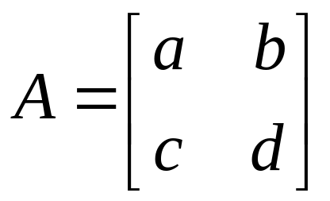
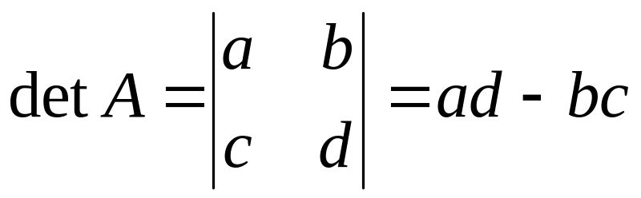
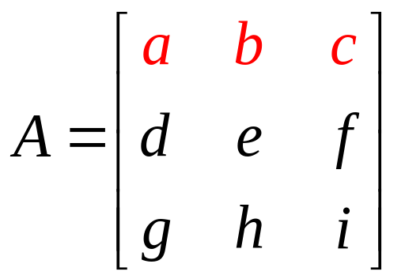
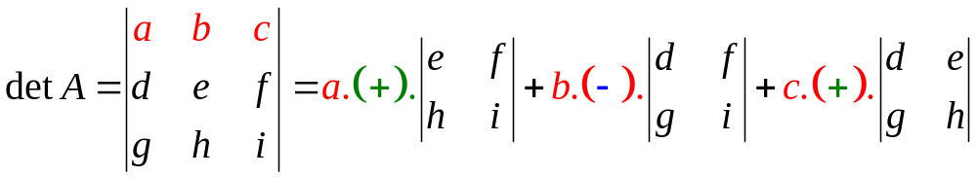
3.1. The Cofactor Expansion
If A=[a] then the determinant of A, denoted by detA=a
If A is an 2x2 matrix then
If A is an 3x3 matrix then the determinant of A is defined by
+
-
+

Slide 4
The determinant of 3x3 matrix

Slide 5
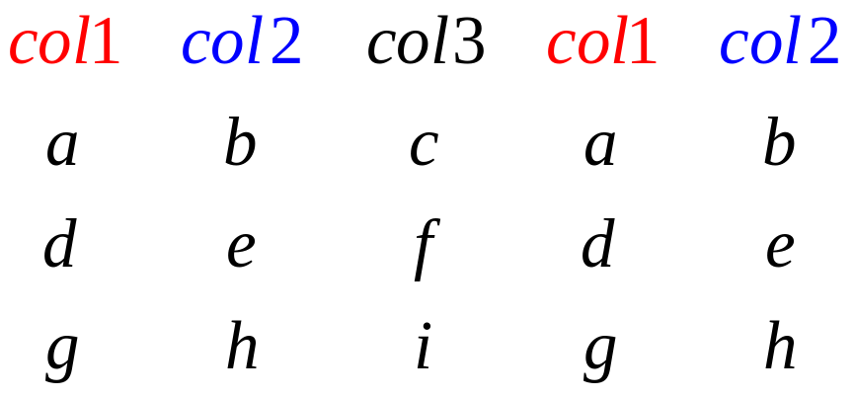
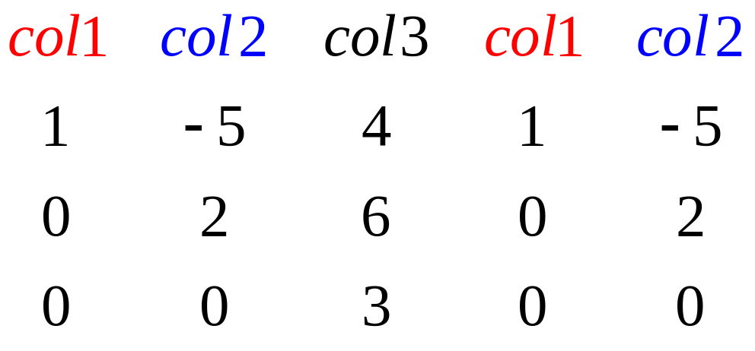
The determinant of 3x3 matrix
-
-
-
+
+
+

Slide 6
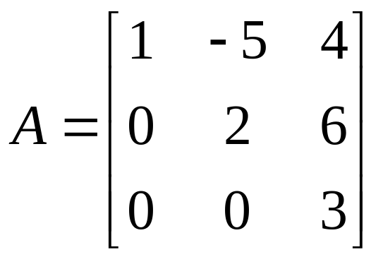
Find detA if
-
-
-
+
+
+
Note that : only use with 3x3 matrices

Slide 7
How to define the determinant of an mxm matrix?

Slide 8
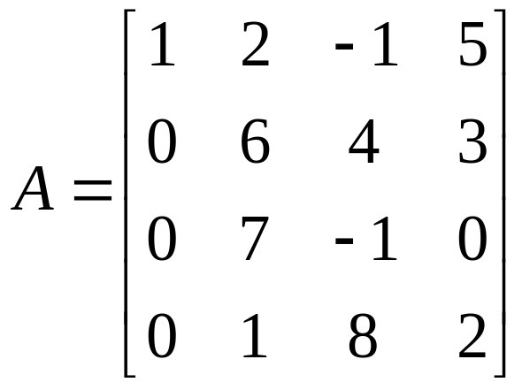
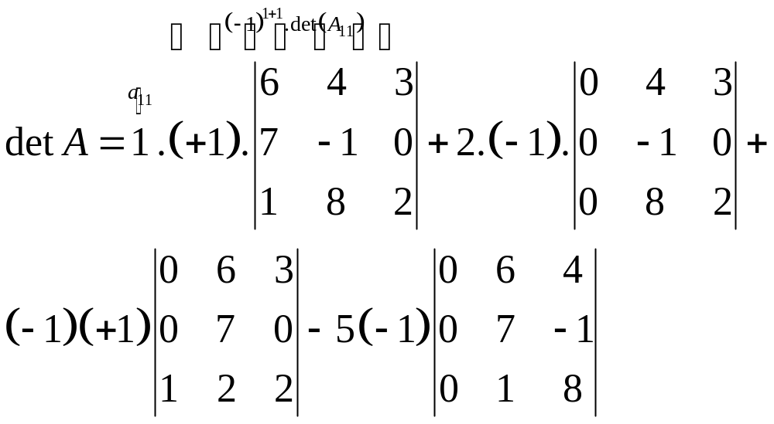
Matrix A₁₁

Slide 9
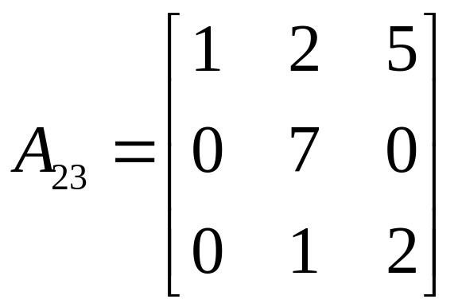
The (i,j)-cofactor
(phần phụ đại số)
If A is an mxm matrix then the (i,j)-cofactor of A is defined by
c_{ij}(A)=(-1)^{i+j}det(A_{ij})
A_{ij} is the (m-1)x(m-1) matrix obtained from A by deleting row i and column j of A
For example, c₂₃(A)=(-1)²⁺³det(A₂₃)=-14

Slide 10
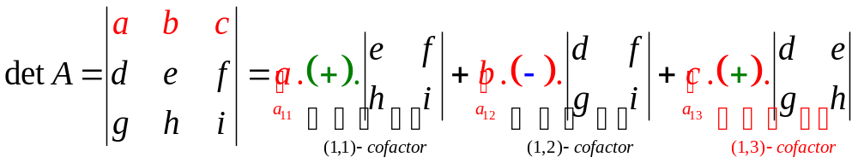
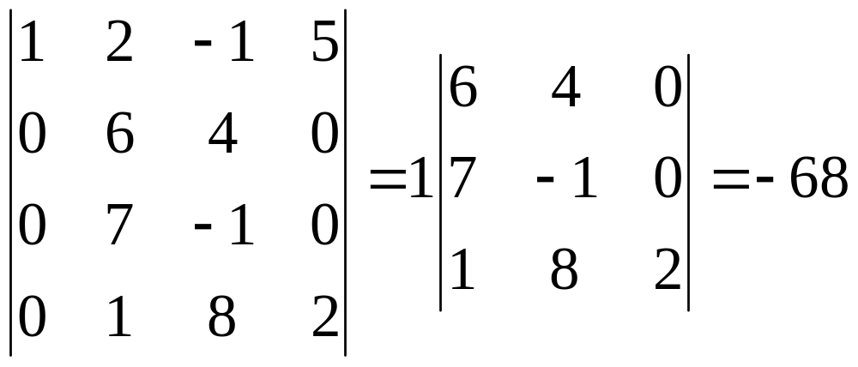
Definition
If A is an mxm matrix then the determinant of A is defined by
detA=a_{i1}c_{i1}(A)+a_{i2}c_{i2}(A)+…+a_{im}c_{im}(A)
or detA= a_{1j}c_{1j}(A)+a_{2j}c_{2j}(A)+…+a_{mj}c_{mj}(A)

Slide 11
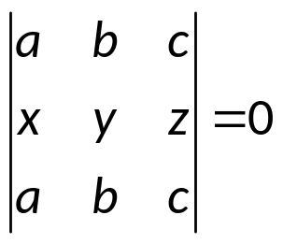
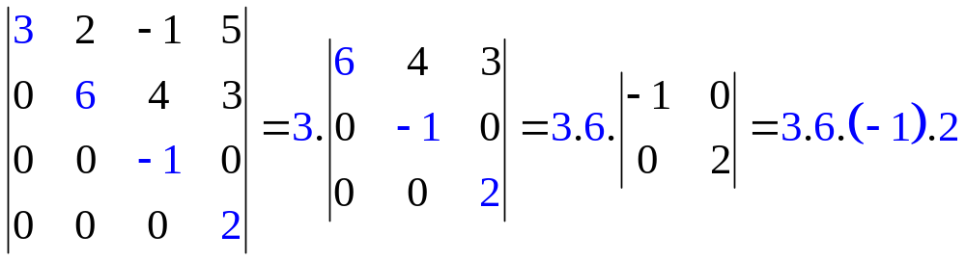
Properties
If A has one row of zeros then detA=0
If A has two identical rows(columns) then detA=0
If A is an triangular matrix then detA is the product of the entries on the main diagonal
Upper triangular

Slide 12
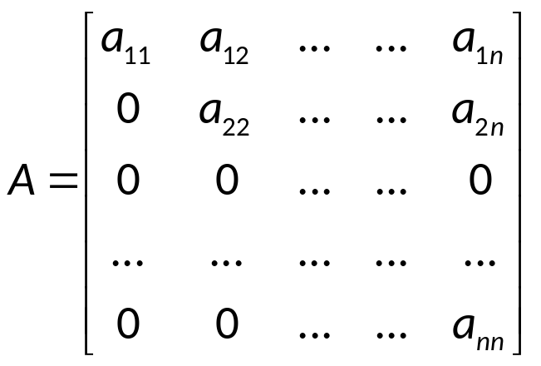
Example
Suppose A is an triangular matrix, a₁₁=4 and c₁₁(A)=11. What is the product of all entries on the main diagonal?
A)11 B)44 C)-11 D)-44
detA=a₁₁c₁₁(A) + a₂₁c₂₁(A) + … = a₁₁c₁₁(A)
Upper triangular

Slide 13
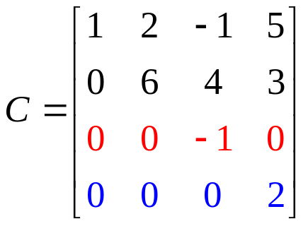
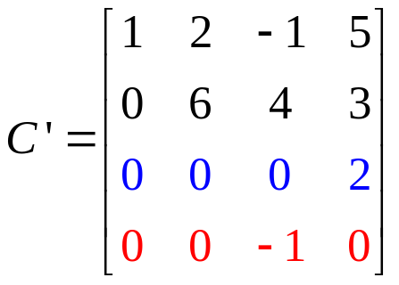
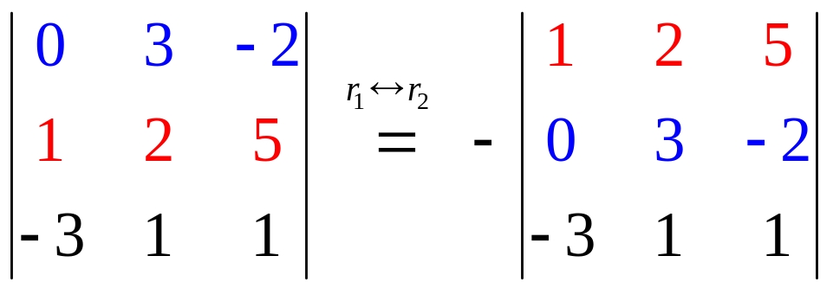
Determinants and elementary operations
If B obtained from A by interchanging two rows (or columns) then detB=-detA
For example, detC’=-detC=12

Slide 14
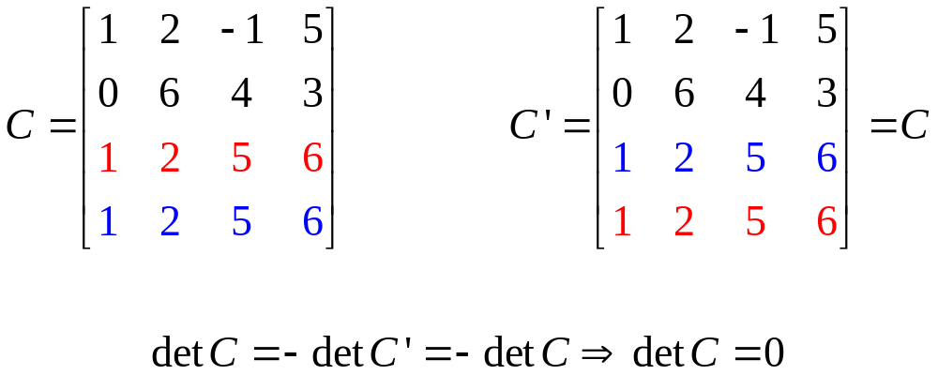
Examples
If two rows (or columns) of a matrix is the same then the determinant is zero

Slide 15
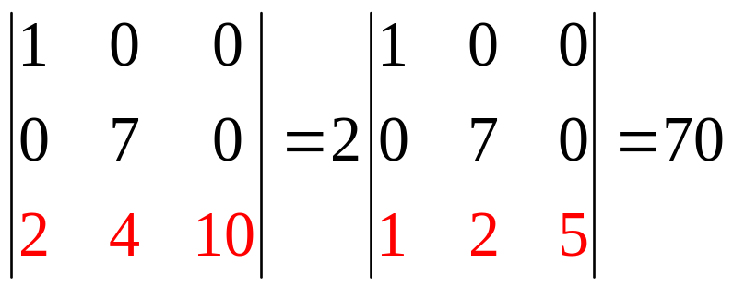
Determinants and elementary operations
If B is the matrix obtained from A by multiplying one row (or cloumn) by a nonzero number k then detB=kdetA
For example, detA’=35, detA=2detA’=2.35=70

Slide 16
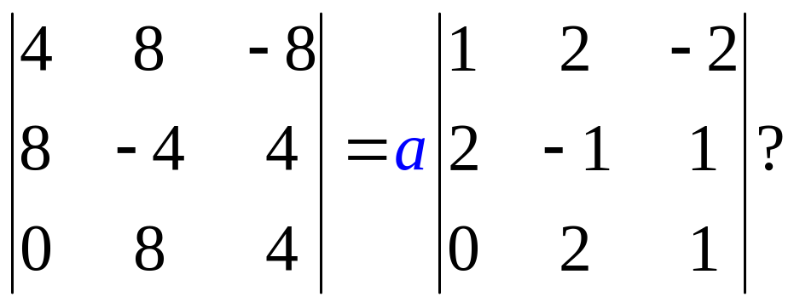
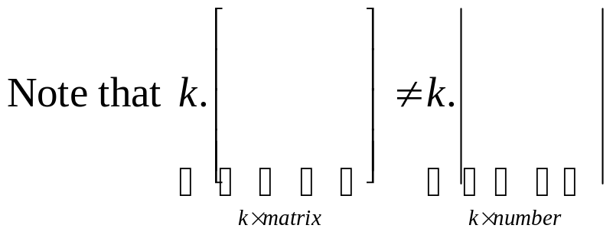
Examples
Find a such that
a) 4 b) 12 c) 48 d)64
Note that a|A| means number a multiplies number |A| while
aA means number a multiplies matrix A

Slide 17
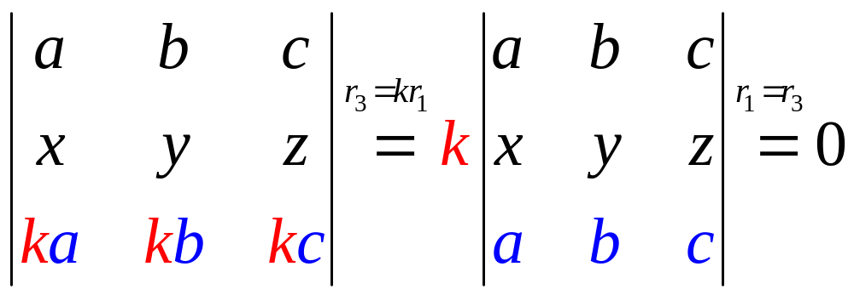
properties
If A is a square matrix that one row(column) is a multiple of another row(column) then the determinant of A is zero

Slide 18
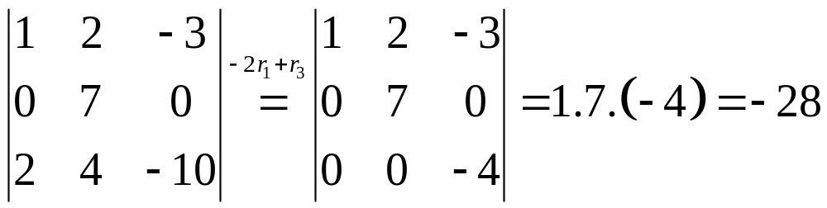
Determinants and elementary operations
If B is the matrix obtained from A by adding a multiple of one row (or column) to another row (or column) then detB=detA
For example,

Slide 19
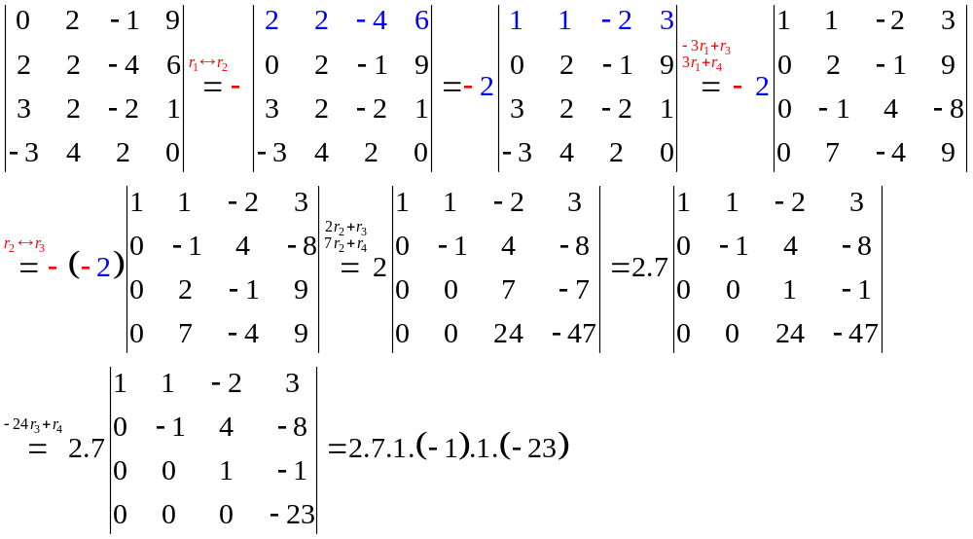
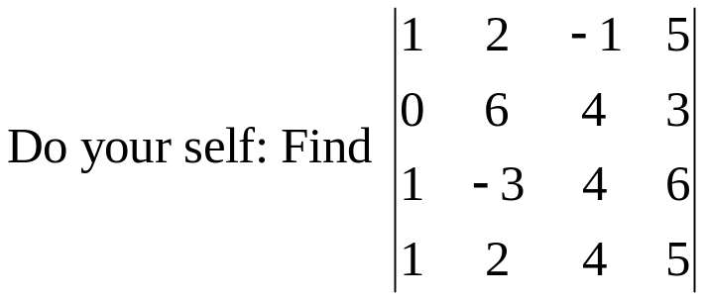
Examples

Slide 20
Theorem
detA=det(A^{T})
det(AB)=detA.detB
If A is an nxn matrix then det(kA)=k^{n}detA
Note that det(A^{k})=(detA)^{k}
det(A+B) ≠ detA+detB

Slide 21
detA⁻¹=1/detA
We have A.A⁻¹ = I_{n}
So, det(AA⁻¹)=detA.det(A⁻¹)=detI_{n}=1
Then,
det(A⁻¹)=1/detA

Slide 22
Example
Suppose A is a nxn matrix, and k is a scalar.
Which of the following is(are) false?
det(A^{T})=detA b) det(AB)=detAdetB
c) det(A+B)=detA+detB d) det(kA)=kdetA
e) det(kA)=k^{n}detA
Answer: c,d

Slide 23
Example
Let A and B are nxn matrices. Which statement is false?
det(A⁻¹BA)=detB b) det(AB⁻¹A⁻¹B)=1
c) detAdetA⁻¹=1 d) detAdetA^{T}=1
e) det(A^{T}B)=det(B^{T}A)
det(AB)=detA.detB
det(A^{T})=detA
detA.det(A⁻¹)=1
Answer: d only

Slide 24
3.2.Determinant and Matrix Inverses
If A is invertible then A→Identity matrix
If detA ≠0 and A→B by elementary operations then detB ≠0
A is invertible iff detA≠0
Cramer’s Rule
Give a formula to find A⁻¹

Slide 25
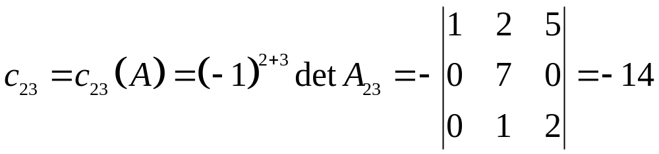
(i,j-Cofactor
(phần phụ đại số)
c_{ij}=c_{ij}(A)=(-1)^{i+j}det(A_{ij}) ( it is a number)
A_{ij} is the matrix obtained from A by deleting row i and column j
Che cột 3
Che dòng 2

Slide 26
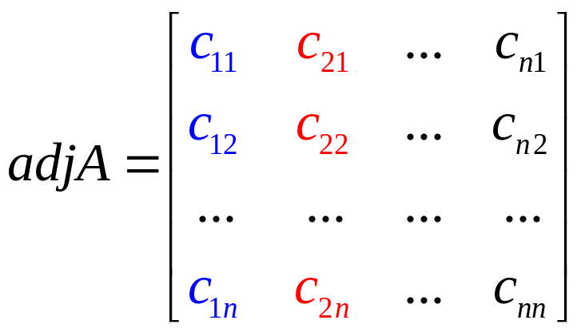
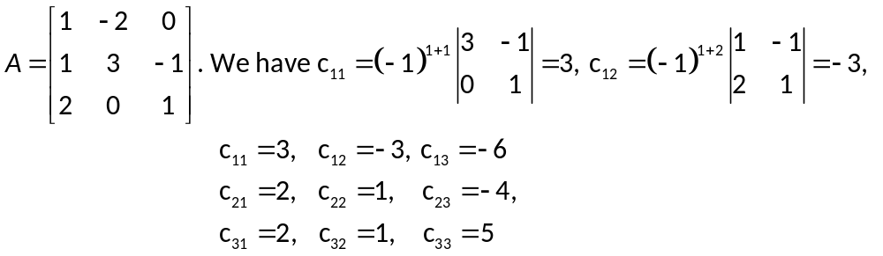
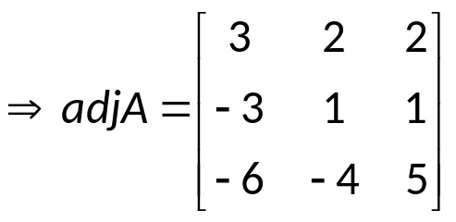
Adjugate matrix
The adjugate matrix of A is the matrix
For example,

Slide 27
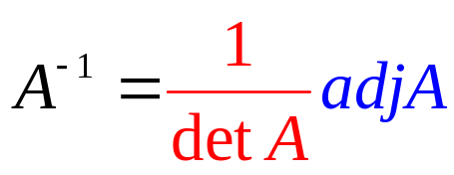
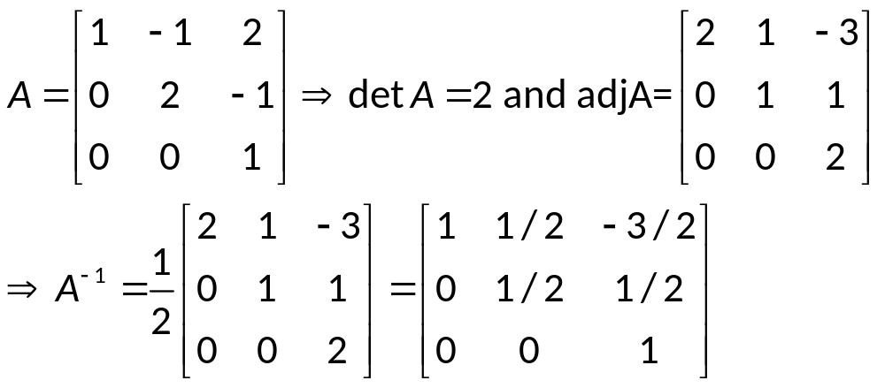
Theorem of Adjugate Formula
If A is any square matrix, then
A(adjA)=(detA)I
In particular, if detA≠0 then A is invertible and
For example,
Note that […]

Slide 28
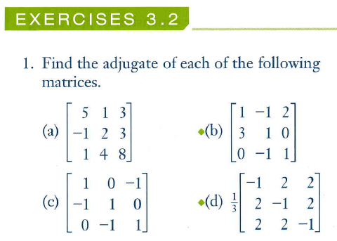

Slide 29
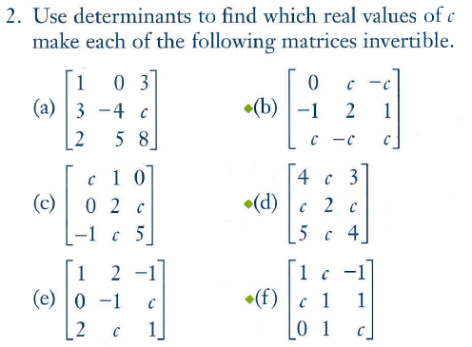

Slide 30
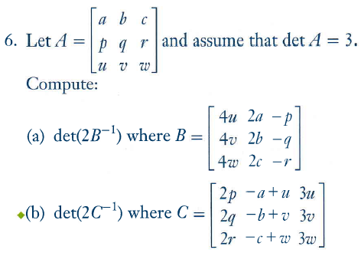

Slide 31
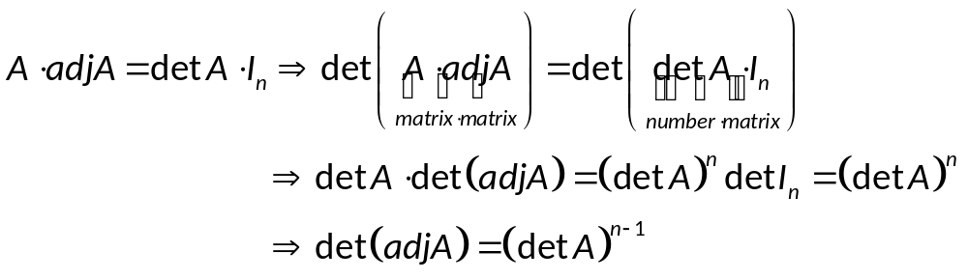

Example
Let A be a 2x2 matrix with detA=3.
Find det(adjA)?
a) 1/3 b)1/2 c)2 d) 3
Answer: d

Slide 32
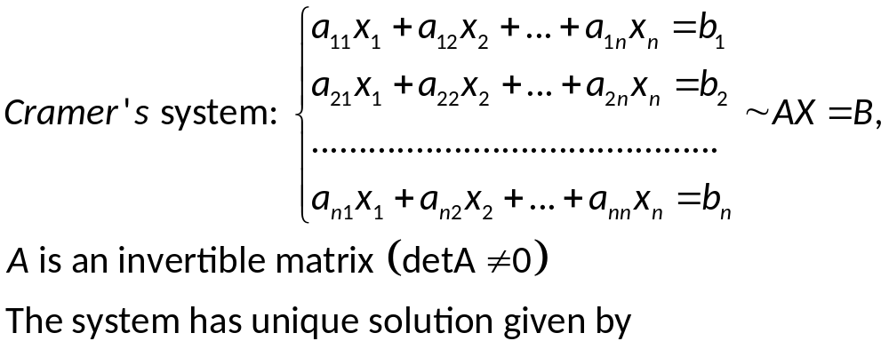
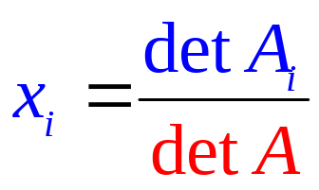
Cramer’s Rule
Cramer’s system: system of n equations involving n variables and has unique solution. So, the coefficient matrix is invertible
A is invertible iff detA≠0

Slide 33
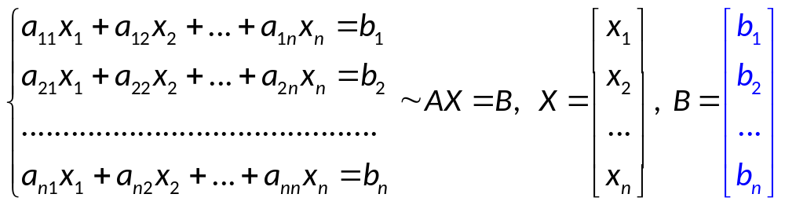
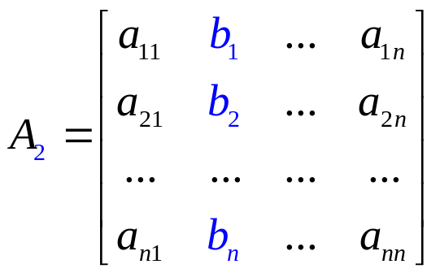

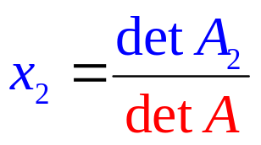
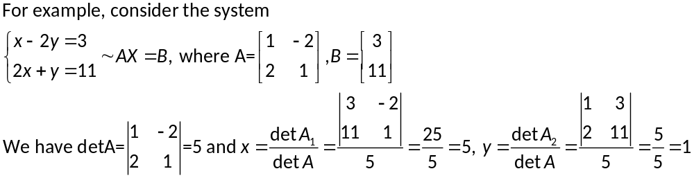
Cramer’s system: AX=B
A

Slide 34
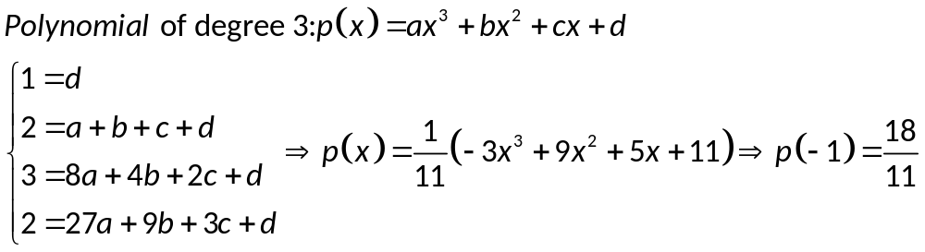
Polynomial Interpolation (nội suy bằng đa thức)
A quadratic polynomial (polynomial of degree 2) : p(x)=a+bx+cx²
A cubic polynomial (polynomial of degree 3): p(x)=a+bx+cx²+dx³
A polynomial of degree n: p(x)=a₀+a₁x+a₂x²+…+a_{n}x^{n}
For example, given the data points (0,1);(1,2);(2,3);(3,2), find the interpolating polynomial of degree 3 and estimate the value of y corresponding to x=-1
(2,3)
(1,2)
(3,2)
(0,1)

-1
Notes:
Thăm dò dự báo nhiệt độ, dự báo giá,…

Slide 35
Determine whether the statements is true or false.
The determinant of a square matrix equal to the sum of all entries of this matrix.
The determinant of a square matrix is a matrix with same size.
The determinant of a square invertible matrix always eaqual to 1.
The determinant of a square matrix is 0 if it is not invertible.
By elementary operations, we can find the determinant of a square matrix.
Suppose A, B, C are square matrices satisfying A=BC and A is not invertible. Then B or C is not invertible.
Suppose A, B, C are square matrices satisfying A=BC and A is invertible. Then B and C are invertible.
If AB=AC, then B=C.
If AB=0 then A=0 or B=0.
If A is invertible, then A^{k} is invertible for all positive integer k.

Slide 36
Thanks
Notes:
p.148: 1ad; 2af; 3ab; 5; 6ab; 7ac; 9ab; 24ac

Slide 37
